Slide 1
Parallel Programming Tools and Models
Jesús Labarta
Barcelona, February 2014

Slide 2
vision

Slide 3
Look around …
We are in the middle of a “revolution”

Slide 4
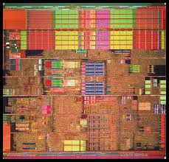
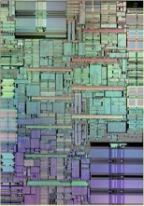
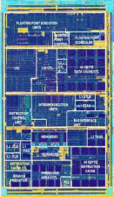
Living in the programming revolution
At the beginning there was one language
Programs “decoupled”
from hardware
Applications
Simple interface
Sequential program
ISA / API
ILP

Slide 5
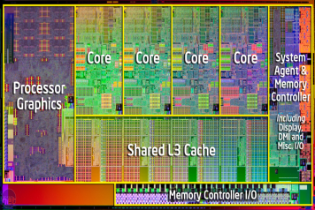
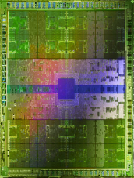
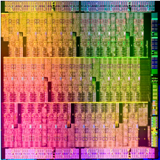
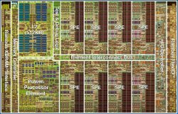
Living in the programming revolution
The power wall made us go multicore and the ISA interface to leak → our world is shaking
Applications
Application logic
+
Platform specificites
Applications
ISA / API
Address spaces (hierarchy, transfer), control flows, …

Slide 6
The parallel programming revolution
Parallel programming in the past
Where to place data
What to run where
How to communicate
Talk to Machines
Dominated by Fears/Prides
Parallel programming in the future
What data do I need to use
What do I need to compute
hints (not necessarily very precise) on potential concurrency, locality,…
Talk to Humans
Dominated by Semantics
Schedule @ programmers mind
Static
Complexity: Divergence between our mental model and reality
Variability
Schedule @ system
Dynamic

Slide 7
The programming revolution
Revolutions
Change everything so that “nothing” changes
Change in age/epoch. Change in mentality/attitude
Of the masses, not just the “revolutionaries”
Are not instantaneous, span a non negligible time
Even if “simple” fundamentals requires a real “effort” and maturation
We are living a quiet revolution:
The multicore revolution? The programming revolution?
From Stone to Bronze? Middle to modern to contemporary ...?

Slide 8
The programming revolution
An age changing revolution
From the latency age …
performance dominated by latency in a broad sense
I need something … I need it now!!!
Rooted in the Von Newmann model: write serial, execute serial
…to the throughput age
Performance dominated by overall availability/balance of resources
I need this and this and that … and as long as it keeps coming I am ok

Slide 9
From the latency age to the throughput age
It will require a programming effort !!!
Must make the transition it as simple as possible
Must make it as long lived as possible
Need
Simple mechanisms at the programming model level to express potential concurrency, letting exploitation responsibility to the runtime
Dynamic task based, asynchrony, look-ahead, malleability
A change in programmers mentality/attitude
Top down programming methodology
Think global, of potentials rather than how-to’s
Specify local, real needs and outcomes of the functionality being written

Slide 10
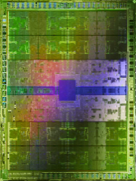

BSC Vision in the programming revolution
Need to decouple again
Application logic
Arch. independent
Applications
PM: High-level, clean, abstract interface
General purpose
Task based
Single address space
Power to the runtime
“Reuse” architectural ideas under
new constraints
ISA / API

Slide 11
Vision in the programming revolution
Fast prototyping
Applications
Special purpose
Must be easy to develop/maintain
DSL2
DSL3
DSL1
PM: High-level, clean, abstract interface
Power to the runtime
General purpose
Task based
Single address space
ISA / API
“Reuse” architectural ideas under
new constraints

Slide 12
Key issues
Programming model and run time
Language to express ideas
Smooth transition path, long lived efforts
Runtime responsible for mapping them to resources
Performance analysis tools
Avoid flying blind
How can we improve?
The importance of details
Need much more “Performance analytics”
Algorithms
Final target
A say in the solution

Slide 13
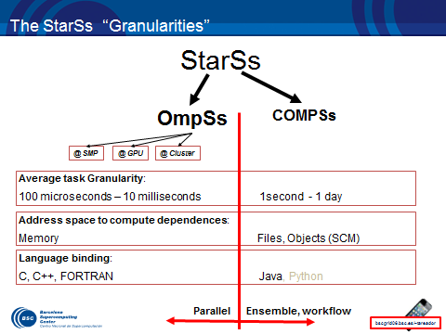
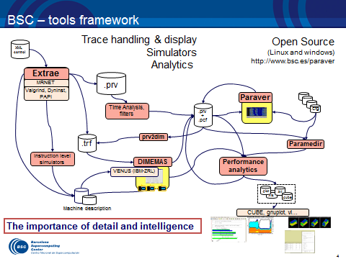
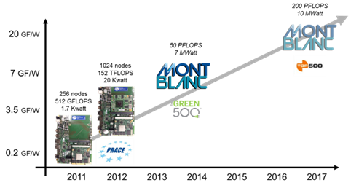
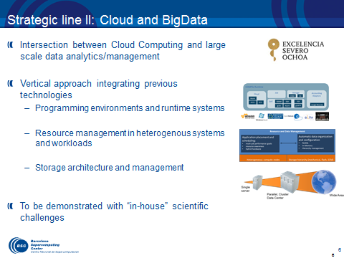
BSC technologies
Programming model
The StarSs concept (*Superscalar) :
sequential programming + directionality annotations → Out of order execution
The OmpSs implementation → OpenMP Standard
Performance tools
Trace visualization and analysis:
extreme flexibility and detail
Performance analytics
Architecture background
Low power architectures
Big data
Integration of
workflow models and runtimes
Resource management
Storage architecture and management

Slide 14
Programming models
Jesús Labarta
Barcelona, February 2014

Slide 15
The StarSs family of programming models
Key concept
Sequential task based program on single address/name space
Discipline
Blocked to achieve sufficient granularity → performance
Directionality annotations
Executed Parallel
Automatic run time computation of dependencies between tasks
Decouple programs form architectures
Presents an abstract view of “essentials”
In specifying computation demands/needs
Only fundamentals of architecture, not so much specificities

Slide 16
Differentiation of StarSs
Dependences: Tasks instantiated but not ready. Order IS defined
Lookahead
Avoid stalling the main control flow when a computation depending on previous tasks is reached
Possibility to “see”/explore the future searching for further potential concurrency
Locality aware
Without defining new concepts
Homogenizing heterogeneity
Device specific tasks but homogeneous program logic

Slide 17
The StarSs “Granularities”
StarSs
OmpSs
COMPSs
@ SMP
@ GPU
@ Cluster
Average task Granularity:
100 microseconds – 10 milliseconds 1second - 1 day
Address space to compute dependences:
Memory Files, Objects (SCM)
Language binding:
C, C++, FORTRAN Java, Python
Parallel Ensemble, workflow, cloud

Slide 18
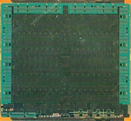

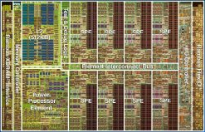
History / Strategy
StarSs
COMPSs
~2007
COMPSs
ServiceSs
~2010
COMPSs
ServiceSs
PyCOMPSs
~2013
CellSs
~2006
GPUSs
~2009
GridSs
~2002
StarSs
~2008
PERMPAR
~1994
SMPSs V1
~2007
SMPSs V2
~2009
DDT @
Parascope
~1992
NANOS
~1996
OmpSs
~2008
Forerunner of OpenMP
OpenMP … 3.0 …. 4.0 ….
2008
2013

Slide 19
Recommendation
Global: On full real application
Strategy: Do not try to apply blindly everywhere
Measure:
Observe real behavior.
Identify feature to benefit from:
Asynchrony between computations, locality, dynamic load balance, portability to heterogeneous systems, overlap computation and communication or I/O,, …
Estimate potential gain.
Think global – specify local
Data flow, abstract
In terms of problem logic, not in terms of resources !!!!
Rapid prototyping
Incremental development
Implement simplest approach. Measure again.

Slide 20
Performance Tools
Jesús Labarta
Barcelona, February 2014

Slide 21
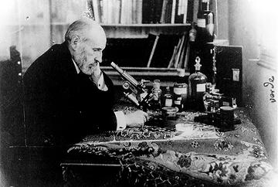
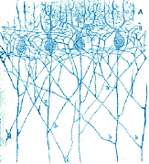
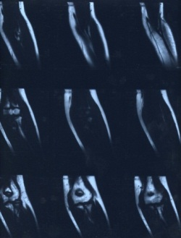
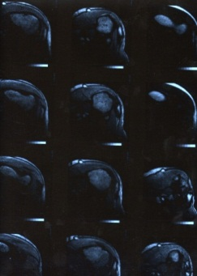
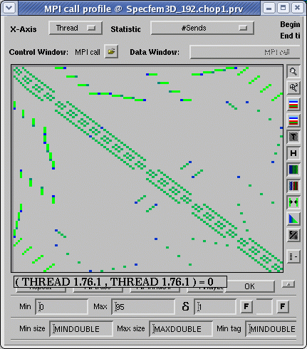
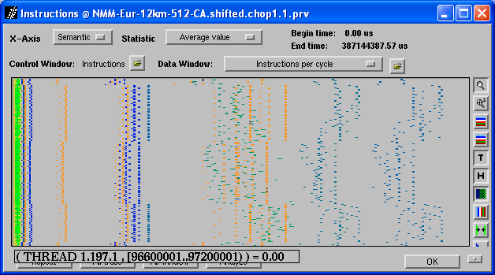
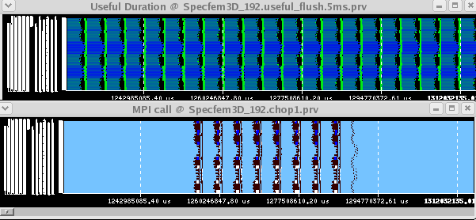
Why Tools ?
Measurement techniques as enablers of science
Are becoming vital for program development at exascale
Fly with instruments: survive the unexpected, …
Not to shoot blind: Work in the right direction
Are important for “Lawyers”
Know who to blame
Are vital for system architects
Understand our systems, productivity
Performance analyst:
A specialist understanding displays

Slide 22
Performance analysis tools objective
Help generate hypotheses
Help validate hypotheses
Qualitatively
Quantitatively

Slide 23
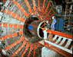
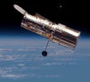
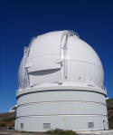
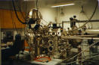
Tools in …
Computer Science
printf()
timers
Performance analysis:
A lot of speculation
We see
we talk about
Science
Advances linked to capability of observation and measurement

Slide 24
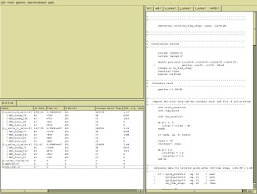
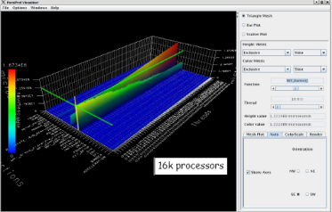

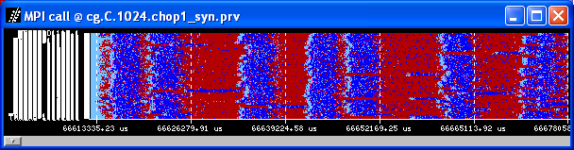
Performance analysis universe
Acquisition
Presentation
Profile land
Function list, in descending order by exclusive time
-------------------------------------------------------------------------
[index] excl.secs excl.% cum.% incl.secs incl.% samples procedure (dso: file, line)
[4] 4.500 97.4% 97.4% 4.500 97.4% 150 bmod (LUBb: LUBb.f, 122)
[5] 0.060 1.3% 98.7% 0.060 1.3% 2 genmat (LUBb: prepost.f, 1)
[6] 0.060 1.3% 100.0% 0.060 1.3% 2 bdiv (LUBb: LUBb.f, 85)
[1] 0.000 0.0% 100.0% 4.620 100.0% 154 __start (LUBb: crt1text.s, 103)
[2] 0.000 0.0% 100.0% 4.620 100.0% 154 main (libftn.so: main.c, 76)
[3] 0.000 0.0% 100.0% 4.620 100.0% 154 LUBb (LUBb: LUBb.f, 1)
Sampling land
CUBE
Xprofiler
Paraprof
Perfexplorer
mpiP
PAPI
Processors/processes
Time
Event types
Vampir
Paraver
Instrumentation land
PMPI
Dyninst, PIN
TAU instrumenter
Compiler options
Timeline
land

Slide 25
Performance Analytics
Dominant practice
We focus a lot on capturing a lot of data
but we present either everything or first order statistics
and require new experiments without squeezing the potential information from the previous one
Need for performance analytics
Leveraging techniques from data analytics, mining, signal processing, life sciences,…
towards insight
and models

Slide 26
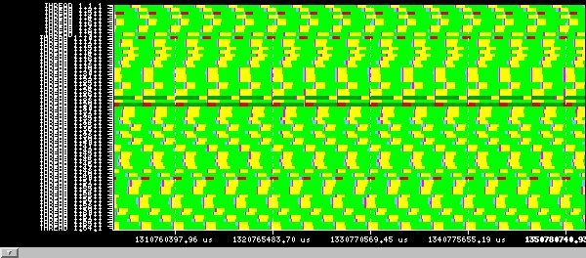
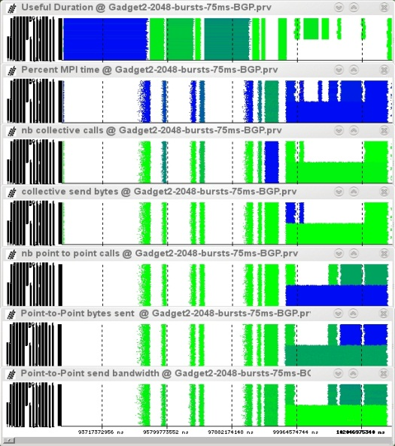
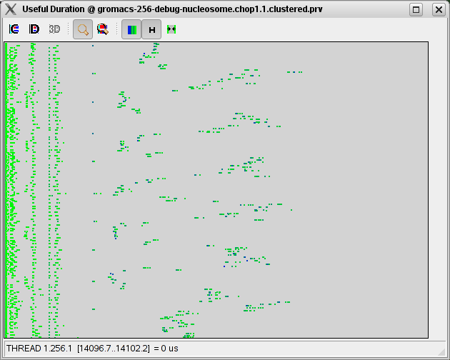
Our Tools
Since 1991
Based on traces
Open Source
http://www.bsc.es/paraver
Core tools:
Paraver (paramedir) – offline trace analysis
Dimemas – message passing simulator
Extrae – instrumentation
Focus
Detail, flexibility, intelligence

Slide 27
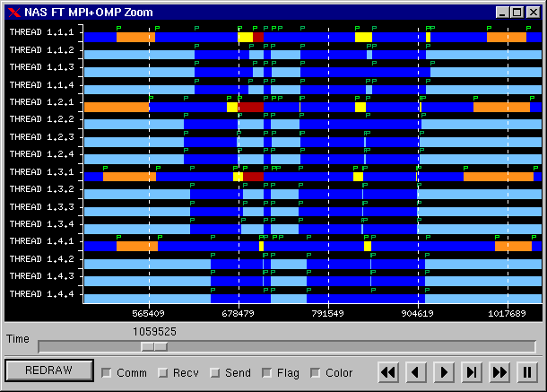
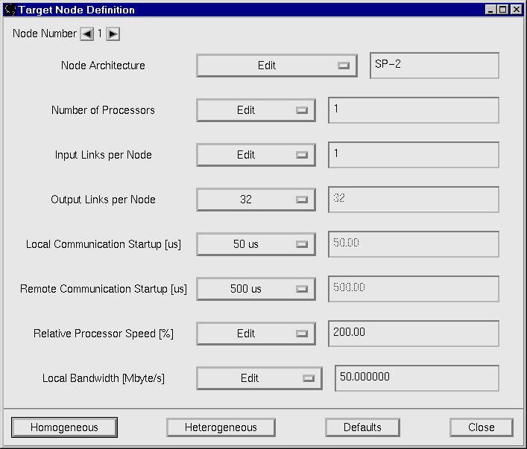
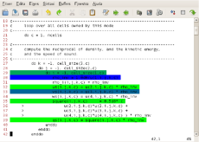
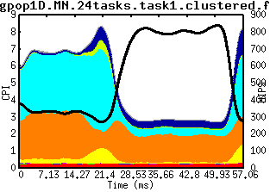
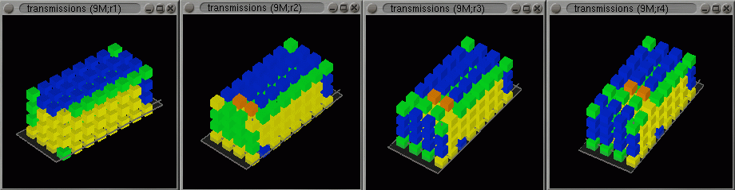
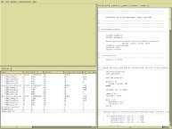
BSC – tools framework
Trace handling & display
Simulators
Analytics
Open Source
(Linux and windows)
http://www.bsc.es/paraver
XML
control
Extrae
.prv
MRNET
Valgrind, Dyninst, PAPI
Paraver
Time Analysis, filters
.prv
+
.pcf
.cfg
.trf
prv2dim
Paramedir
Instruction level simulators
Performance analytics
DIMEMAS
VENUS (IBM-ZRL)
.plot
.xls
.txt
.cube
Machine description
CUBE, gnuplot, vi…
The importance of detail and intelligence

Slide 28
Paraver

Slide 29
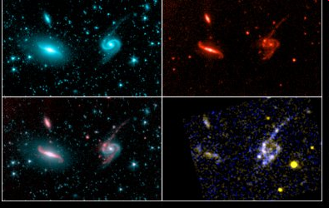

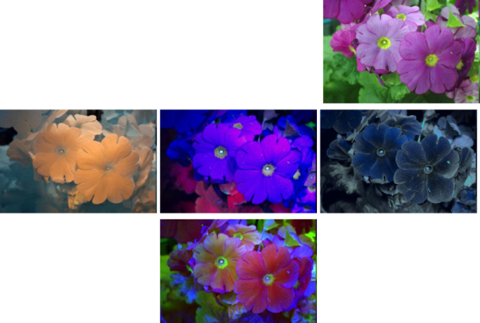
Multispectral imaging
Different looks at one reality
Different spectral bands (light sources and filters)
Highlight different aspects
Can combine into false colored but highly informative images

Slide 30
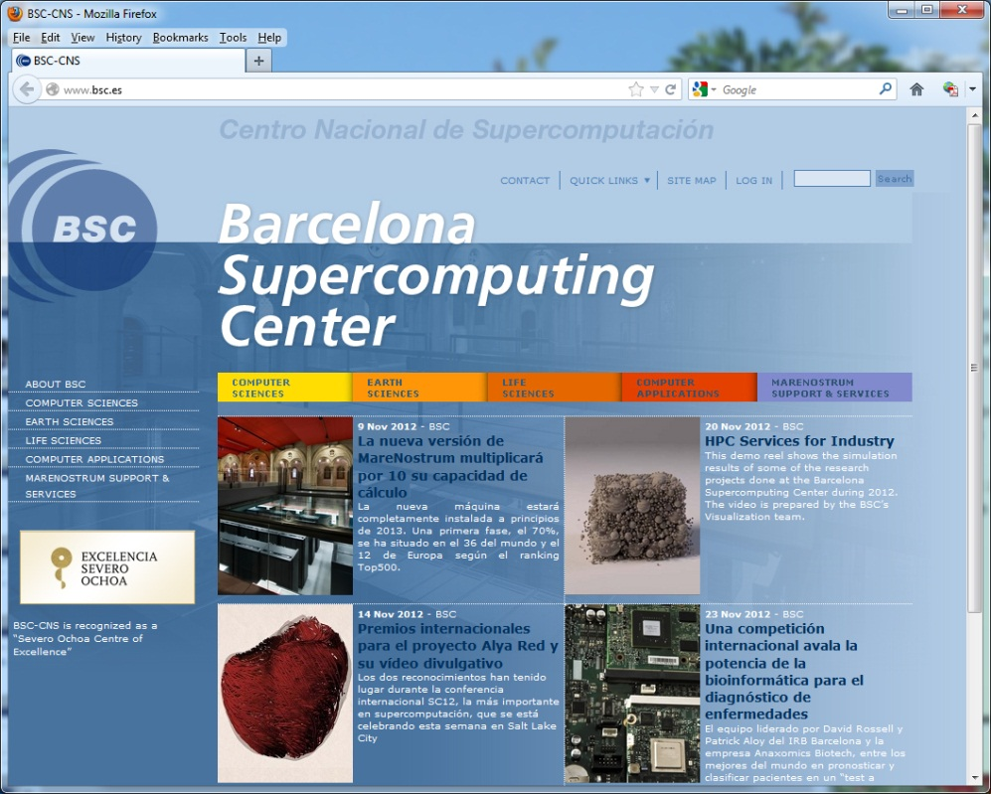
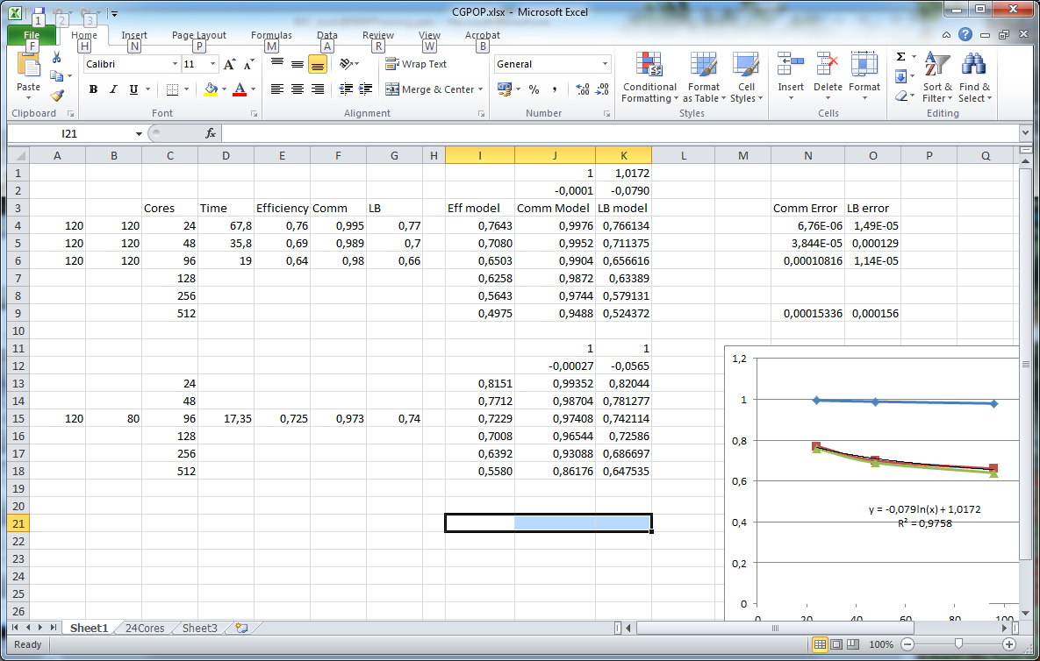
Spreadsheets and browsers
Display, manipulate data
User defined operations

Slide 31
Instruments
One experiment
“Expensive” resources
Lots of analysis
To obtain sufficient information/insight
Avoid flying blind
Identification of productive next steps

Slide 32
A “different” view on performance analysis and tools
Behavioral structure vs. syntactic structure
Algorithmic and performance
In space and time
Variability
Multimodal distributions
Variability + synchronization → critical non linear effects
Flexibility to let analyst navigate the captured data and gain as much insight as possible from as few application runs as possible.
“That what is simple is rarely understood”
my iPads Shangai cookies

